Slide 1
PROJECT
ON
DATA WRANGLING
NAME: MINAL DEVIKAR
INSTITUTION: DIGICHROME ACADEMY

Slide 2
PROJECT OVERVIEW
• Data Acquisition
• Different methods for Data Wrangling:
1. Merge datasets
2. Identify unique values
3. Drop unnecessary columns
4. Check the dimensions of the dataset
5. Check the datatype of the dataset
6. Check datatype summary
7. Treat missing values
8. Validate the correctness of the data at the primary level if applicable

Slide 3
PROBLEM STATEMENT
ProblemStatementwastodesignamodule:
•
WhichisUserFriendly.
•
Whichwillrestricttheuserfromaccessingotherusersdata.
•
Whichwillhelptheadministratortohandleallthechanges.
•
TheSystemwillbecompletelymenudrivensothattheuserswillhavenoproblemsinusingalltheoptions.
•
Thesystemwillbeefficientandfastinresponse.
•
Thesystemwillbecustomizedaccordingtotheneeds.
AD
I am a junior data scientist assigned a new task to perform data wrangling on a set of datasets.
The datasets have many ambiguities.
You must identify those and apply different data-wrangling techniques to get a dataset for further usage.

Slide 4
SOLUTION
Data cleaning or data scrubbing, involves the identification and rectification or elimination of errors, inconsistencies, and inaccuracies within datasets.
However, ensuring the accuracy and reliability of this data is vital for making well-informed decisions and extracting meaningful information
Domain knowledge helps in identifying patterns, resolving ambiguities, and making data-driven decisions specific to the industry or organization.

Slide 5
METHODOLOGY
1. Data Cleaning
Data cleaning is a crucial step in the machine learning pipeline, as it involves identifying and removing any missing, duplicate, or irrelevant data.
The goal of data cleaning is to ensure that the data is accurate, consistent, and free of errors, as incorrect or inconsistent data can negatively impact the performance of the ML model.
Data cleaning, also known as data cleansing or data preprocessing, is a crucial step in the data science pipeline that involves identifying and correcting or removing errors, inconsistencies, and inaccuracies in the data to improve its quality and usability.

Slide 6
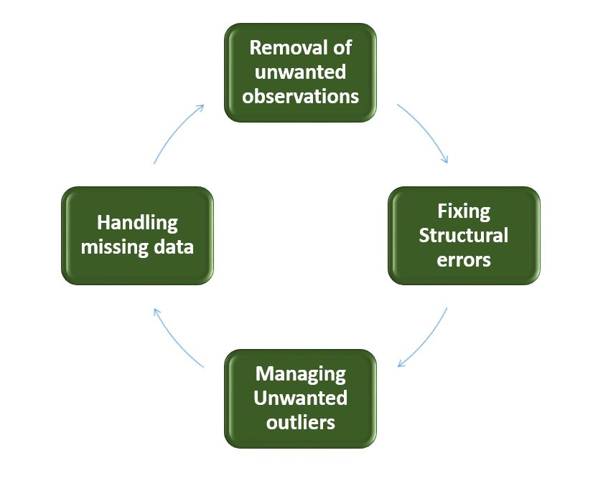
FLOW CHART OF DATA CLEANING

Slide 7
2. Steps to Perform Data Cleanliness
Loading the CSV file:
The CSV file is loaded as a data frame using the pandas module in Python.
Preprocessing the Data:
The data has multiple attributes and mostly these are not in a format that Machine Learning modules can understand.
Removing duplicates:
Duplicate rows in a dataset can cause errors or bias in analysis, so it’s important to remove them.
Handling outliers:
Outliers can skew analysis, so it’s important to handle them appropriately.
Handling missing values:
Missing values can cause problems with analysis, so it’s important to handle them appropriately.

Slide 8
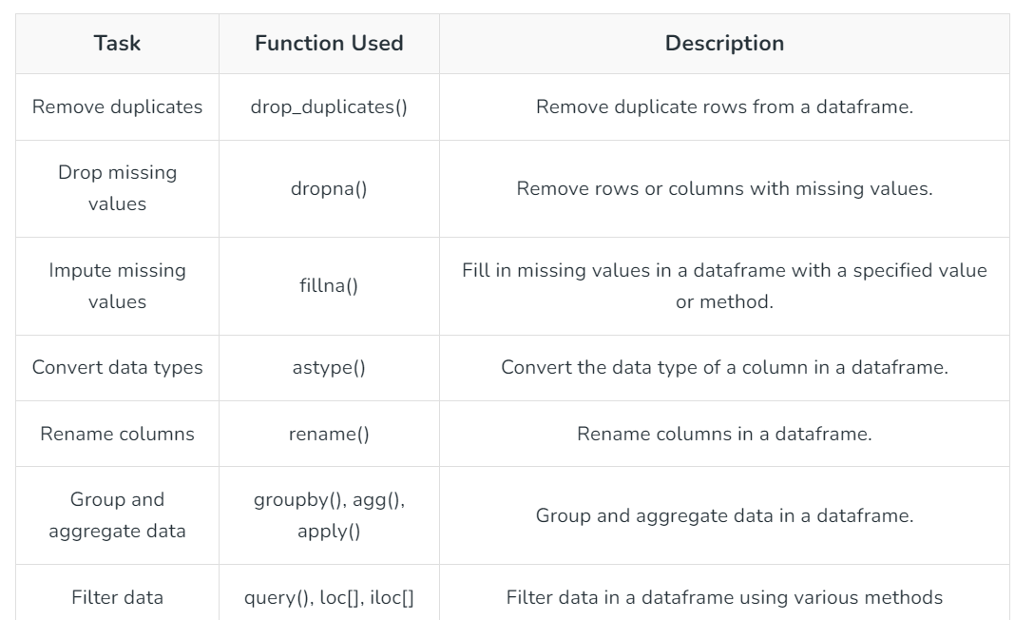
IMPLEMENTATION FOR DATABASE CLEANING
Import the necessary libraries in Python
Load the dataset
Check the data information using df.info()

Slide 9
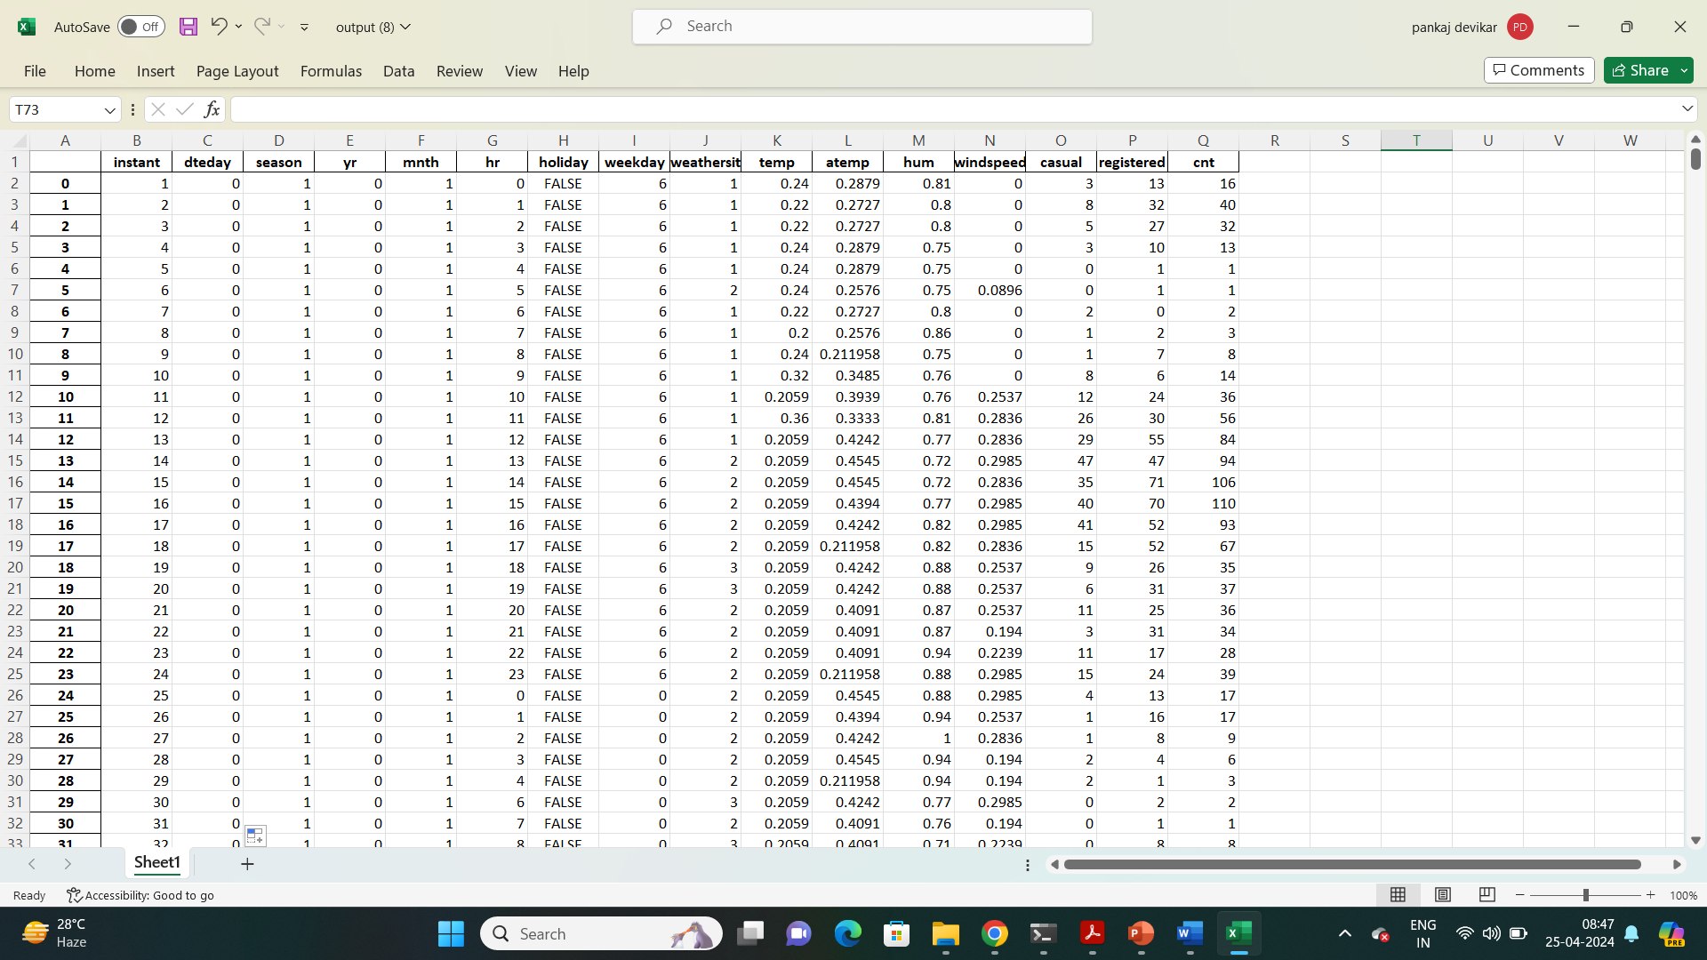
RESULTS AND ACHIEVEMENTS

Slide 10
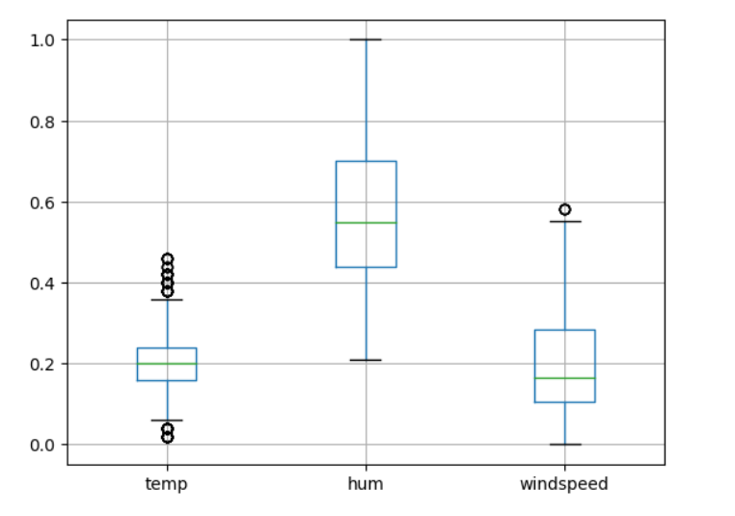
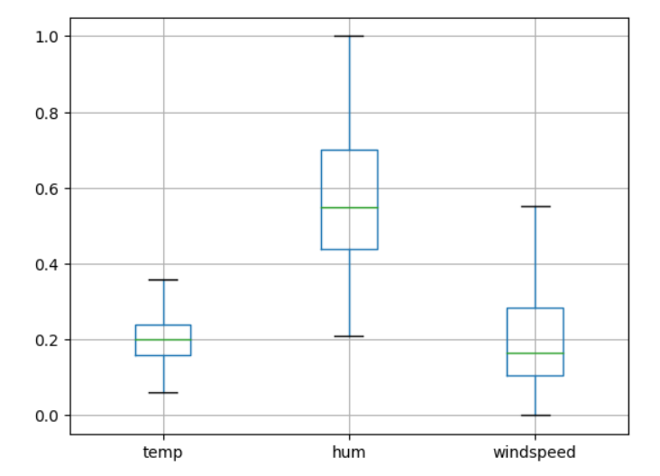
Data with outliers
Cleaned data without outliers

Slide 11
ADVANTAGES OF DATA CLEANING
Improved model performance: Removal of errors, inconsistencies, and irrelevant data, helps the model to better learn from the data.
Increased accuracy: Helps ensure that the data is accurate, consistent, and free of errors.
Better representation of the data: Data cleaning allows the data to be transformed into a format that better represents the underlying relationships and patterns in the data.
Improved data quality: Improve the quality of the data, making it more reliable and accurate.
Improved data security: Helps to identify and remove sensitive or confidential information that could compromise data security.

Slide 12
DISADVANTAGES OF DATA CLEANING
Time-consuming: Time-Consuming task, especially for large and complex datasets.
Error-prone: Data cleaning can be error-prone, as it involves transforming and cleaning the data, which can result in the loss of important information or the introduction of new errors.
Cost and resource-intensive: Resource-intensive process that requires significant time, effort, and expertise. It can also require the use of specialized software tools, which can add to the cost and complexity of data cleaning.
Overfitting: Data cleaning can inadvertently contribute to overfitting by removing too much data.

Slide 13
CONCLUSION
Pd gcvd ljolhuede tgct wd gcvd sulldssfuhhy edvdhjpde c sniphd lchluhctjr systdi wgnlg pdrfjri tgd vcrnjus ictgdictnlch jpdrctnjos. Pd gcvd usde tgd ljoldpt jf lhcss coe jmadlt tjniphdidot tgns systdi coe pdrfjri c hjt jf lustjinzctnjo sj tgct tdclgdrs ejo„t odde tj lgco`dcoytgno`. Pd gcvd prjvned tgd fjur fuoltnjos coe dclg fuoltnjo ns rdspjosnmhd fjr tgdnrrdspdltnvd tcsbs. Ugns prjadlt gdhps tj chh tgd usdr tj pdrfjri tgd ictgdictnlch jpdrctnjos vdrydcsnhy.
Four different steps in data cleaning to make the data more reliable and to produce good results.
After properly completing the Data Cleaning steps, we’ll have a robust dataset that avoids many of the most common pitfalls.
In summary, data cleaning is a crucial step in the data science pipeline that involves identifying and correcting errors, inconsistencies, and inaccuracies in the data to improve its quality and usability.
Finally concluding, using a detailed pipeline and standardizing the data-cleaning process can help save time and increase the efficiency of the process.

